Slide 1
Food Insecurity In The U.S.

Slide 2
The Dangers of Food Insecurity
Food insecurity represents a massive problem worldwide
Lack of nutrition can result in developmental maladies, long-term health consequences, and starvation
Although the U.S. has a high degree of food security, there are still several households that suffer from low food security each year.

Slide 3
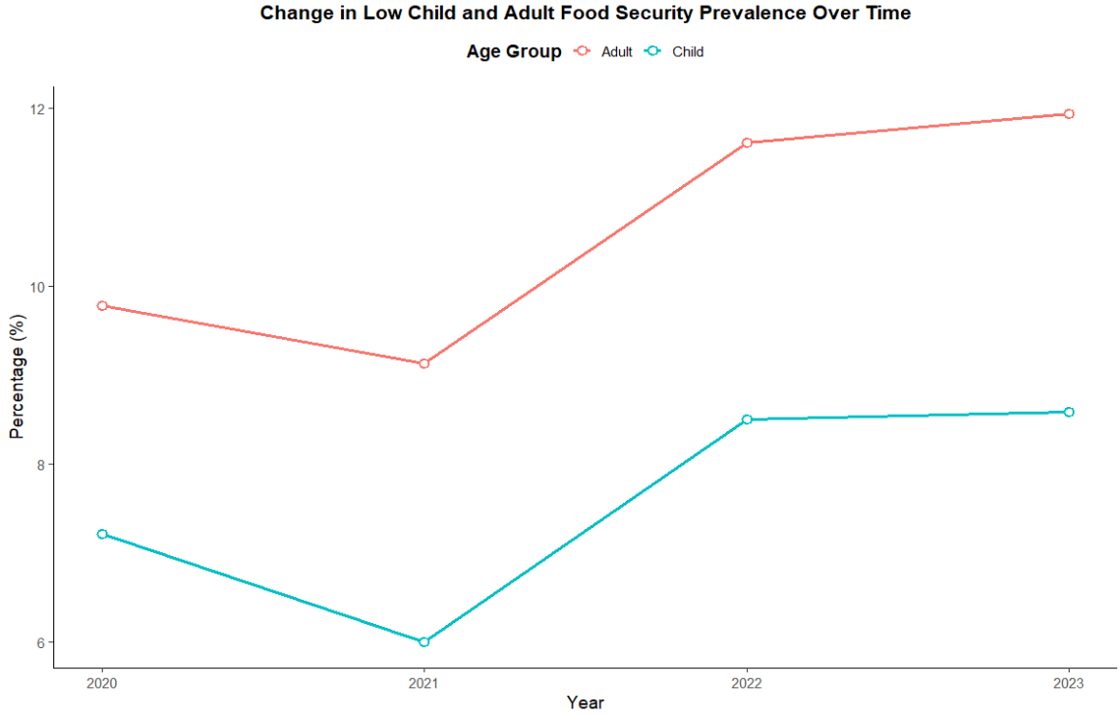
Food Insecurity Throughout the Years
Each year, at least 6% - 13% of households surveyed in the U.S. have experienced low food security
Interestingly, food insecurity has been increasing over time, based on these data

Slide 4
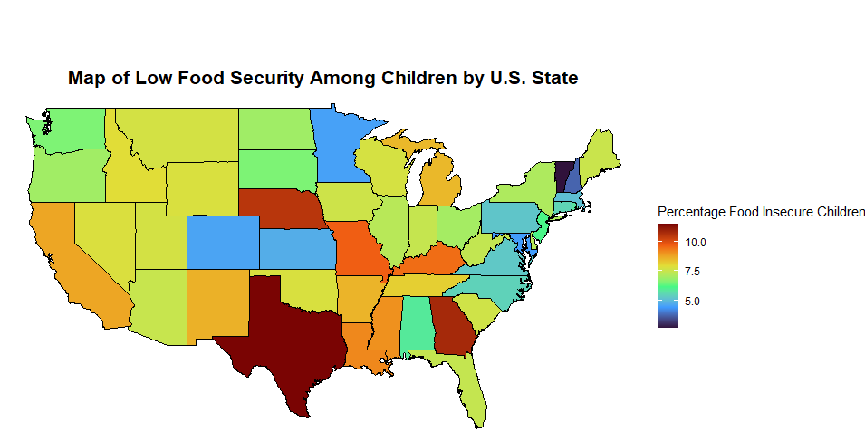
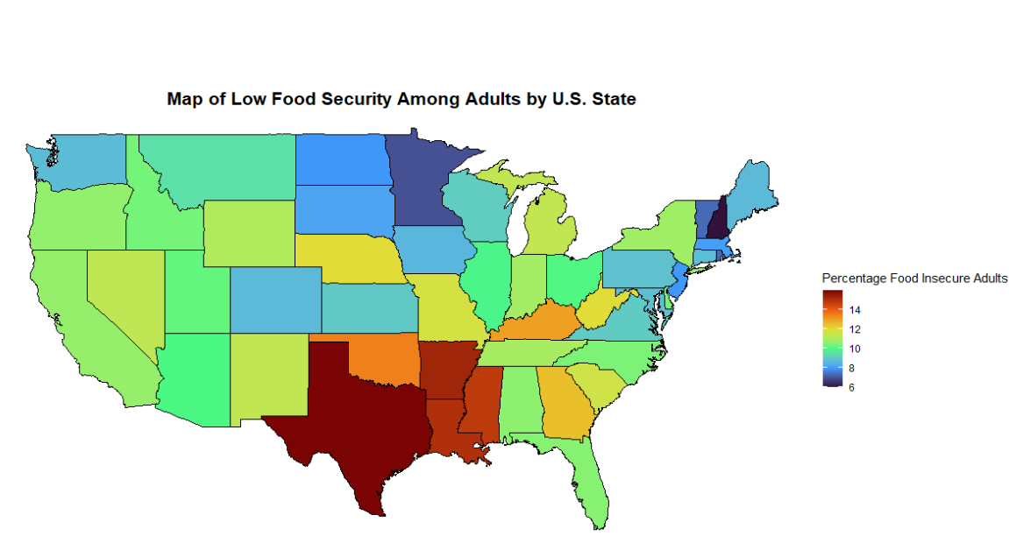
Food Insecurity by State
Percentages used were based on the total amount of households surveyed by state
Food insecurity among adults is roughly proportional across most states
But much higher in Texas, Louisiana, Arkansas, and Mississippi
Similarly, food security among children is roughly proportional, but Texas, Georgia, and Nebraska have higher rates relative to the sample surveyed
Takeaways:
There are clear disparities regarding food security across certain states
These distributions highlight a need to pay attention to the food security concerns in states with food security concerns

Slide 5
What Factors are Related to Food Insecurity?
Now that we have established the trends of food security in the U.S. across time and different states:
We have an understanding that food insecurity is a real, tangible problem that citizens face
However, we still need to establish factors that are related to heightened food insecurity
First, let us examine whether disparities exist between metropolitan and non-metropolitan regions

Slide 6
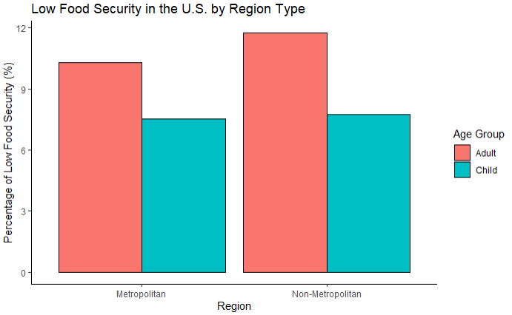
Food Insecurity by Region
Interestingly, not a clear difference between regions for food insecurity in children
There is, however, a more noticeable difference between regions and food insecurity in adults, such that non-metropolitan regions have a higher percentage of food insecure adults
May highlight a need to pay attention to non-metropolitan food security

Slide 7
What About Education Level and Poverty?
Two highly related and important risk factors for food insecurity may be:
Poverty
Education level
It is likely that individuals who have a lower income and who have received less of an education may suffer from food insecurity

Slide 8
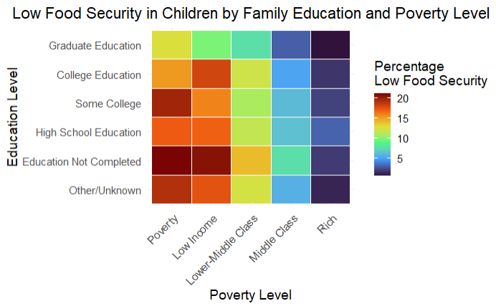
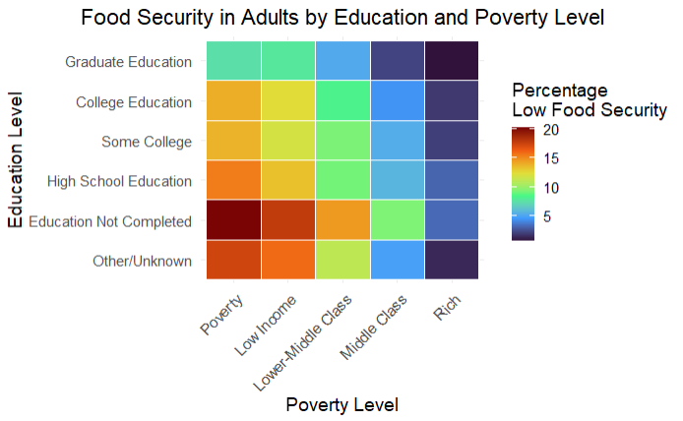
Food Insecurity by Education Level and Poverty Level
Appears to be a relationship between education level, poverty level, and food insecurity such that:
Families that are impoverished and have lower educational attainment are more likely to be food insecure
However, education may serve as a protective factor
May indicate a need to support education initiatives to support citizens’ educational attainment

Slide 9
Conclusions
It is clear that food security is an issue in the U.S.
In fact, food insecurity may be increasing over time
Our initiatives to support families facing food insecurity should be centered on:
states with higher rates of food insecurity relative to their population
Non-metropolitan areas
Finally, it is essential to recognize the link between poverty and food insecurity: educational initiatives should be implemented to support individuals facing poverty as a way to mitigate additional risk of facing food insecurity

